Slide 1



Admin Training
Reports and Advanced Topics

Slide 2
Learning Objectives Reports and Advanced Topics
Teach
(Slides)
Show
(Demo)
Do
(Exercises)
Review
(Q&A)
Creating Reports
API / Jitterbit
Basic Scripting
Scripting Library

Slide 3
1 – Creating Reports

Slide 4
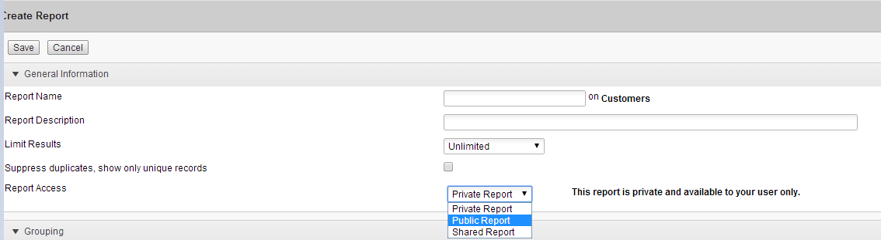
Shared Reports
Private: No one else can view the report
Public: Shared with all users
Shared Report: Shared with users you select

Slide 5
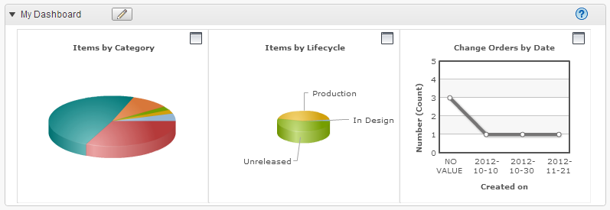
Dashboard

Slide 6
Metrics
Grouping: must be enabled to create graphical metrics
Aggregations: sums & averages

Slide 7
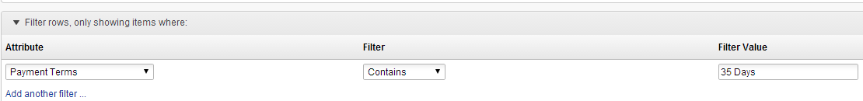
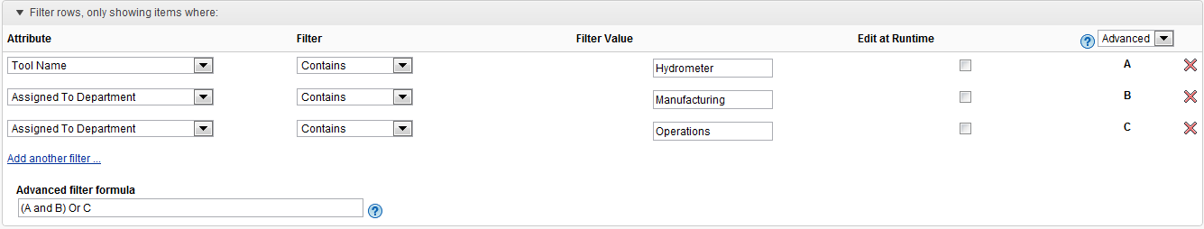
Filtering
Simple
Advanced

Slide 8
Teach
(Slides)
Show
(Demo)
Do
(Exercises)
Review
(Q&A)
Demo Topics Reports
Creating a Report
Sharing Reports
Grouping, display, filtering and sorting
Notes:
Create a report for your custom Items and BOMs Workspace
• Name the report “Items by Category Report”

Slide 9
2 – API / Jitterbit

Slide 10
Teach
(Slides)
Show
(Demo)
Do
(Exercises)
Review
(Q&A)
Demo Topics API / Jitterbit
API
Custom Applications
PDX Exporter
AD User Loader
Fusion Lifecycle Connect
Overview
NetSuite Process Integration
Salesforce Process Integration
Vault Process Integration

Slide 11
Basic Scripting

Slide 12
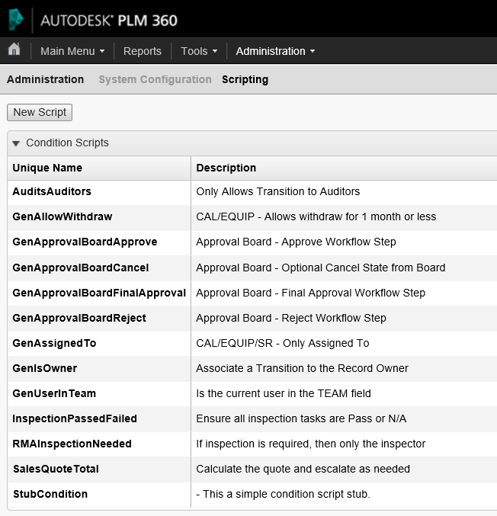
Fusion Lifecycle Script Editor
JavaScript
Script Management
Unique Name
Description
Import a Library
Code
Embedded editor
Tools
Save
Close
Testing
Debug Tool
Error Log

Slide 13
Scripting Types
Condition: returns true/false (Boolean)
Validation: returns a list (array) – empty or populated
Action: does not return a value
Library: holds one or more functions

Slide 14
Teach
(Slides)
Show
(Demo)
Do
(Exercises)
Review
(Q&A)
Demo Topics Basic Scripting
Fusion Lifecycle Script Editor
Script Management
Code
Tools
Script Library

Slide 15
Exercises
Teach
(Slides)
Show
(Demo)
Do
(Exercises)
Review
(Q&A)

Slide 16
Review
Teach
(Slides)
Show
(Demo)
Do
(Exercises)
Review
(Q&A)

